Slide 1
Skeletal animation using shaders
Jan Hurtado

Slide 2
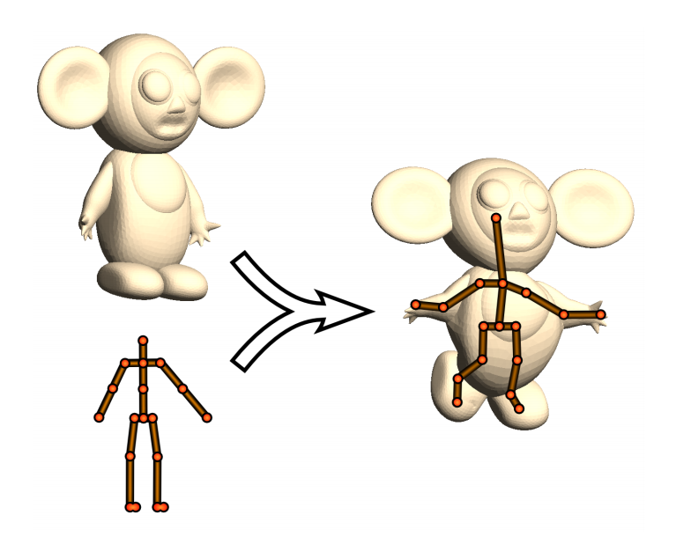
Skeletal animation

Slide 3
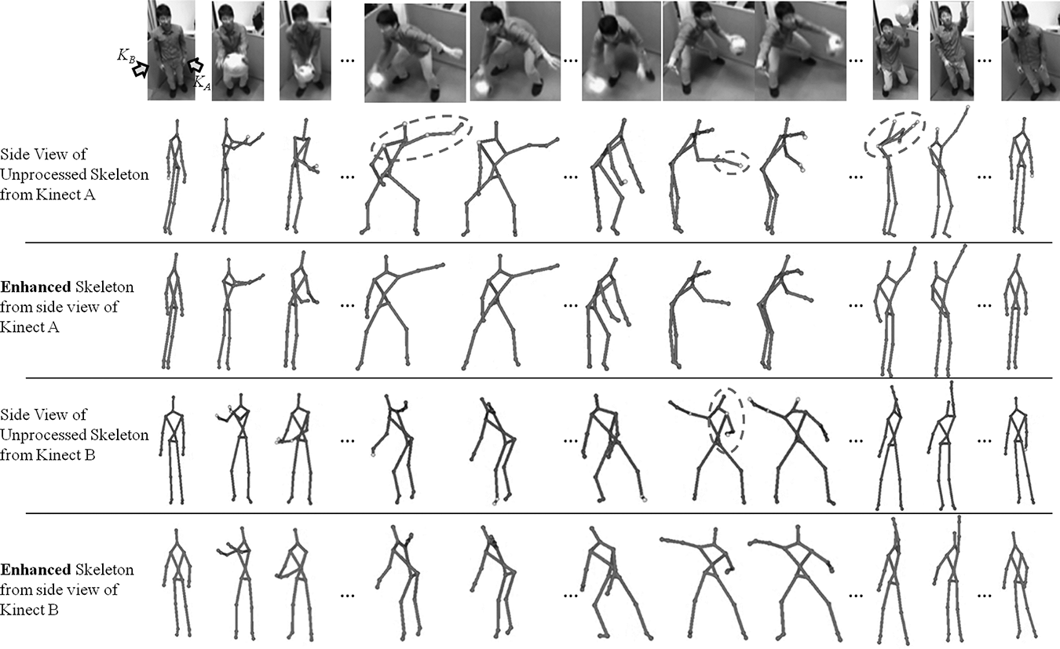
Skeletal motion

Slide 4
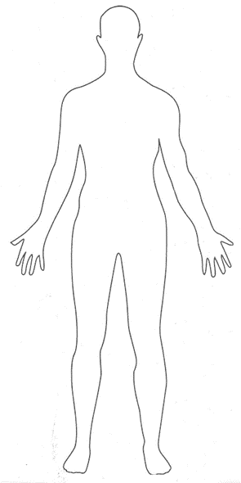

Slide 13
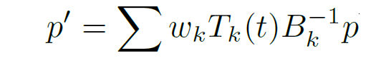
Skeletal subspace deformation

Slide 14
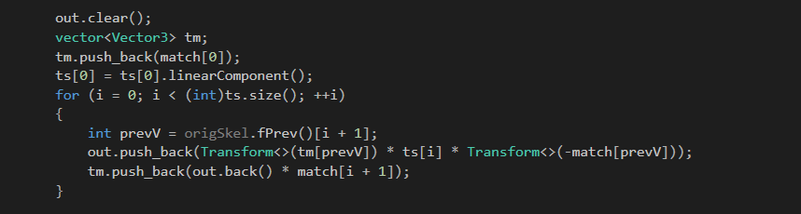

Slide 19
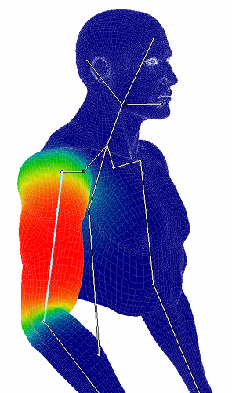
Weight

Slide 20
w=0.5
w=0.5

Slide 21
w=0.5
w=0.5

Slide 22
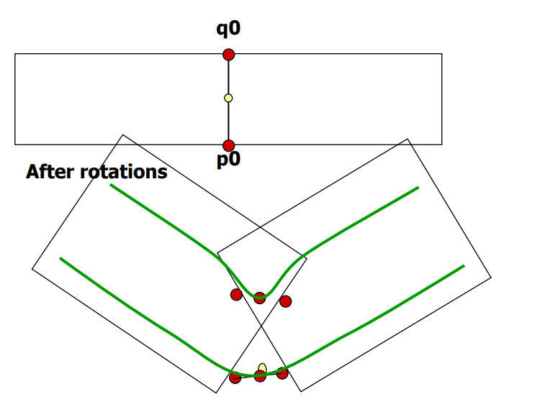

Slide 23
Skeletal subspace deformation

Slide 24
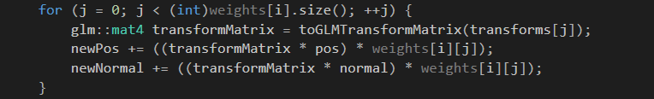

Slide 25
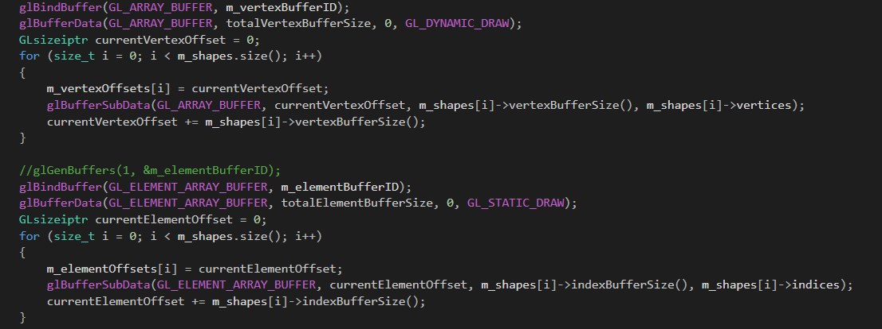
Implementation

Slide 26
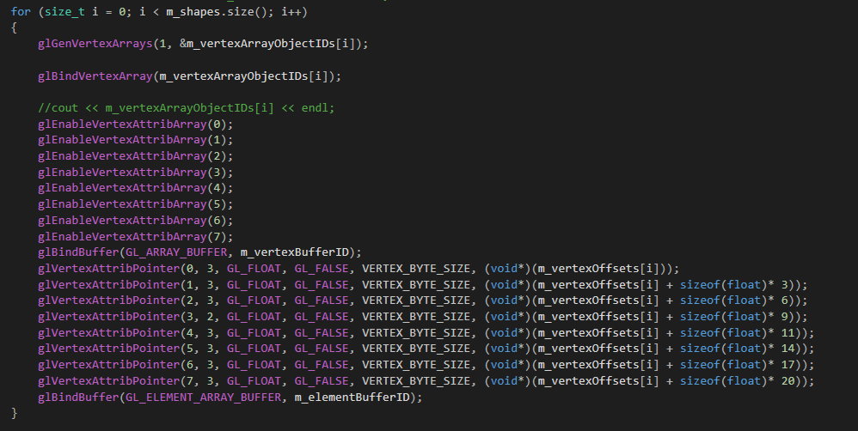
Implementation

Slide 27
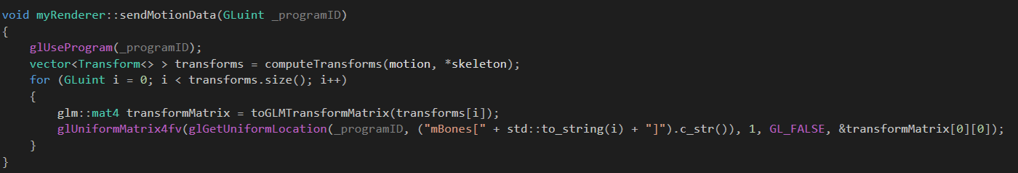
Implementation

Slide 28

Implementation

Slide 29
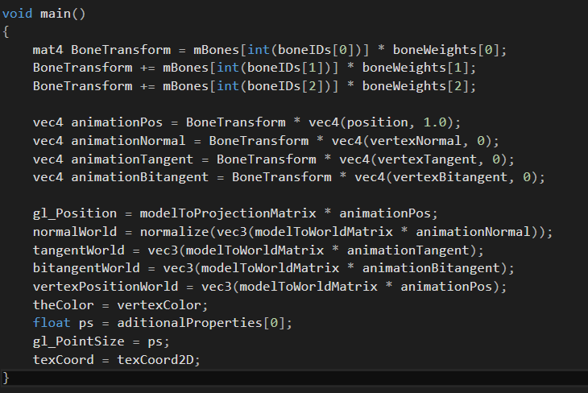
Implementation

Slide 30
Videos

